Slide 1
R Clinic
Session 18
Generalised Linear Models and non-normal distributions
23/09/2015

Slide 2
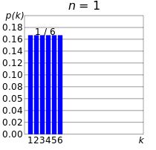
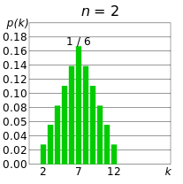
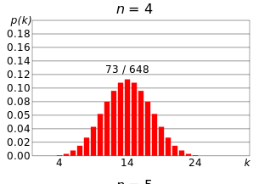
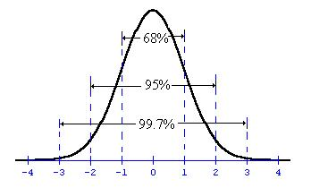
What is normal (Gaussian)? And why do we like it?
Very commonly occurring probably distribution in nature
Useful for describing things that arise from multiple random chances/alleles (e.g. dice games, height, weight etc.)
Basis of parametric statistics, including T-tests, Anova , General Linear Models and F statistics

Slide 3
Checking for normality
Remember that for General Linear Models and General Linear Mixed Models, you must test the residuals of the model for normality.
E.g.
Fit the General Linear Model
> mod_norm <- glm(P~Burnt*Habitat + Site, data = chem)
Look at some plots
> plot(mod_norm)
> hist(residuals(mod_norm))
Test residuals for normality
> shapiro.test(residuals(mod_norm))
# Shapiro-Wilk normality test
# data: residuals(mod_norm)
# W = 0.9391, p-value = 3.212e-05

Slide 4
What to do when things are not normal?

Slide 5
What to do when things are not normal?
Step 1. Feel slightly uncomfortable
Think about your data
Do you have enough samples?
Are there environmental variables you haven’t included?
Are there outliers and why?

Slide 6
What to do when things are not normal?
Step 1. Feel slightly uncomfortable
Step 2. Consider data transformations or Generalised Linear Models
Transforming may be better when in you have problems with variance as well as normality
GLM’s are likely to be better when you have count data, proportion data or presence/absence data
GLM results are often easier to interpret (I think)

Slide 7
What to do when things are not normal?
Step 1. Feel slightly uncomfortable
Step 2. Consider data transformations or Generalised Linear Models
Transforming may be better when in you have problems with variance as well as normality
GLM’s are likely to be better when you have count data, proportion data or presence/absence data
GLM results are often easier to interpret (I think)
Step 3. Realise that having non-normal data is pretty normal in ecology

Slide 8
Generalised Linear Models
Model response data with specified non-Gaussian (non-normal) responses
Can accommodate continuous and categorical explanatory variables
Can account for variable interactions and quadratic terms
Response should be linear
Can be extended to include random factors (GLMM’s)
Note:
Outliers and variance can still be a problem

Slide 9
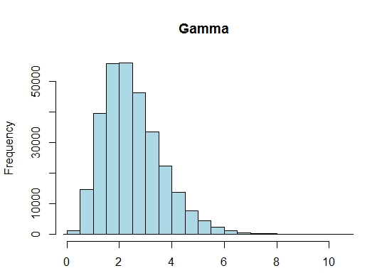
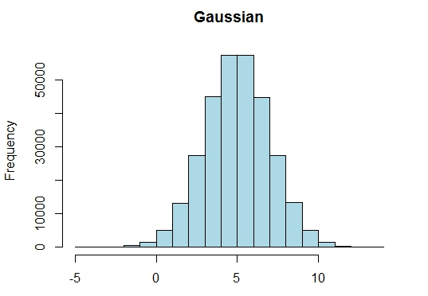
Common distributions for continuous data
Normal distribution
Unbounded
Gamma distribution
Bounded at zero
Positive numbers only

Slide 10
Running a Generalised Linear model in “R”
Function = “glm”
Use standard model format
i.e. glm(dependent variable~Explanatory variable,
data = datasheet)
Specify a distribution family (e.g. “poisson” or “gamma”)
i.e. glm(dependent variable~Explanatory variable,
data = datasheet, family = “gamma”)
Specify a link function (e.g. “log” or “inverse”)
i.e. glm(dependent variable~Explanatory variable,
data = datasheet, family = “gamma”(link = log))

Slide 11
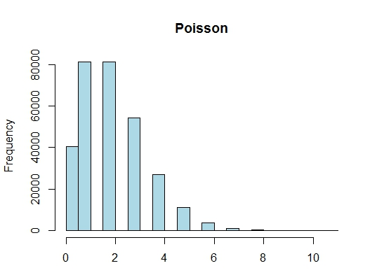
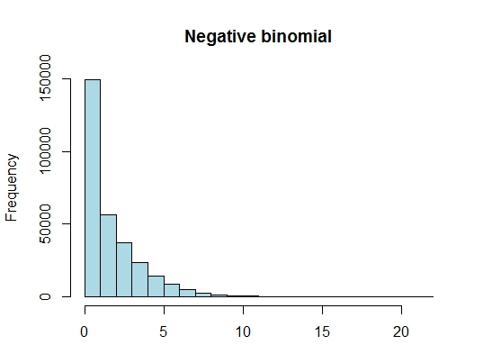
Common distributions for count data
Poisson distribution
Bounded at zero
Positive numbers and zeros accepted
Whole numbers only
Negative binomial distribution
Bounded at zero
Positive numbers and zeros accepted
Whole numbers only
For “overdispersed”/”long-tailed” data

Slide 12
Poisson and “overdispersion”
Negative binomial distributions are for “over-dispersed data”
Specifically, data considered is “over-dispersed”
if “residual deviance/residual degrees of freedom >1”
Residual deviance/residual degrees of freedom is referred to as “theta”
Rule of thumb for this is: we want theta = 1, theta < 2 is okay,
theta >2 and <15 try quassipoisson, theta > 15 try negative binomial
or if you prefer (as I do) go straight to negative binomial at theta > 2
Code example
mod_ARR <- glm(TOT.N ~ D.PARK, data = AAR, family = "poisson"(link = "log"))
theta <- mod_ARR$deviance/mod_ARR$df.residual

Slide 13
Binomial data
Presence/Absence
Yes/No
Coin tosses
1 and 0’s etc.
Use family = binomial
Link “logit” if there is roughly equal numbers of 0’s and 1’s
Use link “cloglog” if there are very different amounts of 0’s and 1’s

Slide 14
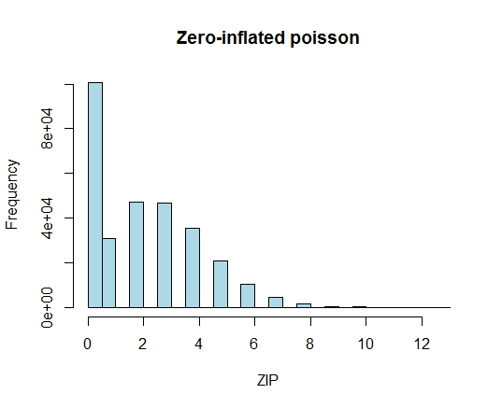
Zero-inflated data
Poisson distribution
Many zeros
Positive numbers and zeros accepted
Whole numbers only

Slide 15
Recap of options
Data type | Dispersion | Distribution Type | Function
Continuous data
 |  | Gaussian or gamma or lognormal | glm (…, family=gaussian/gamma/lognormal)
Count data
 | No overdispersion | Poisson GLM | glm (family = poisson)
 | Some overdispersion | Quasi-Poisson | glm (family = quasipoisson)
 | Strong overdispersion | Negative binomial | library (MASS) glm.nb
Binomial data
 | No overdispersion | Binomial GLM | glm (family = binomial)
 | With overdispersion | Quasi-binomial GLM | glm (family = quasibinomial)
Zero-inflated data
 | No overdispersion | Zero-Inflated Poisson (ZIP) or Zero-Adjusted Poisson (ZAP) | library (pscl) Zeroinfl (dist = "poisson")
 | With overdispersion | Zero-inflated neg. Binomial (ZINB) or Zero-Adjusted Neg. Binomial (ZANB) | library (pscl) zeroinfl (dist = "negbin")

Slide 16


Great books for glms

Slide 17
Feedback
Happy to accommodate requests wherever possible
Survey Monkey
Email
In person

Slide 18
Upcoming sessions
Next week – 2nd of December
Generalised linear mixed models!!

